Slide 1
Leg Warmers
By Dr. N
Evil has never felt so comfy

Slide 2
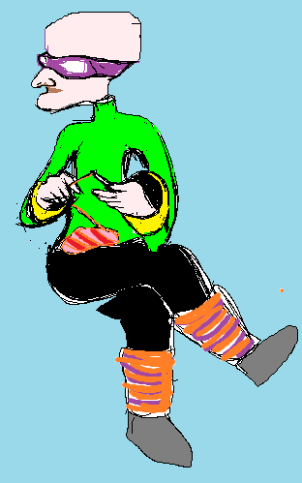

Slide 3
add another layer to your lair
Selling to Humans Use Case
System | Leg Warmers Store
Use Case | Sell Product in store
Actors | Distributor, Shipping, Control, Retail
Description | Customers can browse products through the retail store system. They can view items details. They can buy or just browse
Stimulus | The retail store establishes a connection with control for product details and pictures.
Response | If the human buys, Retail will update it’s on-hand inventory accordingly.

Slide 4
Made by doctor’s hands
System | Leg Warmers Site
Use Case | Sell Products online
Actors | Control, Distributor, Shipping
Description | On the world wide interwebs humans can view our products and may make selections to put in their cart.
Stimulus | For remote humans, a record is kept by control of the transaction, otherwise Retail will batch their records once a week.
Response | Control will contact the Distributor, add shipping and place the order. The summarized data including price, is sent from the distributor to the human
Comments | If a retail store is near to the human, an option for pick-up will be available, and will void shipping charges.

Slide 5
Order today before he changes his mind.
System | Leg Warmers Order
Use Case | Request more products from Dr. N
Actors | Distribution, Dr. N
Description | Call and request a new batch of products. Don’t get your hopes up
Stimulus | Distribution has received notices that stores need to be restocked, but the product is not in house.
Response | Distribution can fax requests to Dr. N. If he is pleased he will knit a new batch. If he is not pleased, well you know…..
Comments | the expense (shipping) for “store orders” will be kept in the records of distribution.

